Slide 1
Empowering Speakers: A Journey to Encourage Women and Diverse Groups at WordCamps
Jill Binder
jillbinder.com Twitter: @jillbinder

Slide 2
A Request About Questions
Please hold questions until end
Notes:
Big topic that can get easily derailed with interesting discussions
We’ll have a big QandA and discussion section

Slide 3
By show of hands
How many have done done public speaking about anything WordPress-related before?

Slide 4
By show of hands
How many haven’t yet but have thought about it?

Slide 5
By show of hands
How many here are organizers of WordPress-related events?

Slide 6
WordCamp Vancouver 2013 Planning Meeting

Slide 7
WordCamp Vancouver 2013 Planning Meeting
40 applications

Slide 8
WordCamp Vancouver 2013 Planning Meeting
52 applications

Slide 9
WordCamp Vancouver 2013 Planning Meeting
40 were applicable

Slide 10
WordCamp Vancouver 2013 Planning Meeting
14 spots

Slide 11
WordCamp Vancouver 2013 Planning Meeting
7 women applied

Slide 12
WordCamp Vancouver 2013 Planning Meeting
6 were a fit

Slide 13
WordCamp Vancouver 2013 Planning Meeting
Added a third track: Increased to 28 spots

Slide 14
WordCamp Vancouver 2013 Planning Meeting
2 women said no to the speaker acceptance for family obligations
X
X

Slide 15
WordCamp Vancouver 2013 Planning Meeting
4 women

Slide 16
WordCamp Vancouver 2013 Planning Meeting
Guess how many men said no for family obligations?

Slide 17
Notes:
Left blank intentionally

Slide 18
WordCamp Vancouver 2013 Planning Meeting
0 men dropped out for family obligations

Slide 19
WordCamp Vancouver Speakers 2013
4

Slide 20
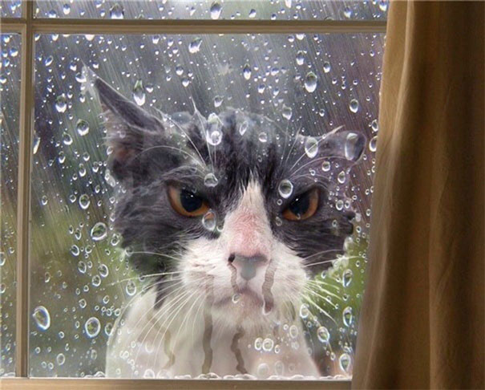
Notes:
Sad cat

Slide 21
What is stopping women?
I chatted with many other organizers at WordCamp San Francisco 2013
Common problem for everyone
We actually had a high number
Wanted to accept more women, but they just weren’t applying

Slide 22
Before I go on…
Going to talk about gender like it’s a binary, even though it’s not; Women blob, men blob
WOMEN
MEN

Slide 23
Why? Who cares? It should be the “best speaker,” right?
(aka speakers who have had a lot of experience speaking…)
Audience not represented by the speakers
Open source users not represented by the speakers
Our speakers help shape our technology
Unique perspectives and multi-roles

Slide 24
What is stopping women?
A lot of reasons
One we can actually do something about:
When we ask women, “Hey, will you speak at my conference?”
Their two most common answers:
Notes:
A lot of societal reason

Slide 25
"I don't know enough about … to give a talk on it."

Slide 26
"What would I talk about?"

Slide 27
Dispelling the “expert” myth
Person who said yes
Impostor syndrome
Expert on your own experiences

Slide 28
My Workshop Idea
Brainstorm
Show they have literally a hundred of ideas (that is how many we generate in an exercise)
(Biggest problem then becomes picking one!)

Slide 29
WordCamp Central
Shaped the workshop

Slide 30
WordCamp Central
Talk formats
How To
Discussion
Panel
Story-based
Case Study
Workshop

Slide 31
Workshop (Vancouver version)
First workshop was shaped by:
Andrea Middleton (WC Central)
Jen Mylo (WC Central)
myself

Slide 32
Workshop (Vancouver version)
Fleshed out by our team in Vancouver:
Vanessa Chu
Kate Moore Hermes
myself

Slide 33
Workshop (Vancouver version)
Second workshop, merged with global work, refined, added content:
First year’s team
Mandi Wise (previous participant who had become a frequent speaker)

Slide 34
Cities that were inspired and created their own workshops
Seattle
Portland
Montreal
Montreal ran it in New York

Slide 35
WordCamp San Fran 2014
Asked us to create workshop script for all diversity
We gathered all the best from Seattle, Montreal, Portland, and Vancouver
Morgan Kay, Kathryn Presner, Tammie Lister, Andrea Middleton, Jen Mylo
(Apologies if I’ve missed anyone)

Slide 36
Workshop Agenda
Introductions
Why are we holding a workshop for
Dispelling speaker myths
Why do you want to speak?
Talk formats
Big Braindump

Slide 37
Workshop Agenda
Narrowing Selection
Refining Chosen Topic
Present Topic
Writing the Proposal
Coming up with a great title
Writing Your Bio

Slide 38
Workshop Agenda
Present Titles and Pitches
Writing The Outline
Present outline
Becoming a Better Speaker
Creating Great Slides

Slide 39
How Else Did We Get More Women?
(Ambitious: Dev Edition)
I networked with more women in WordPress
Online
In person
Our team sent out personal invitations to apply to WordPress women of our tricity region

Slide 40
Encouraged them to speak at small meetups first (WordPress and other, in and beyond Vancouver)
When we asked if they would apply, we mentored them:
Suggest things we know they could talk about
Explain that we didn’t want How-Tos as much as stories
Ask if they have a good story about something that they’ve learned

Slide 41
After all that
Still not many women applications ☹

Slide 42
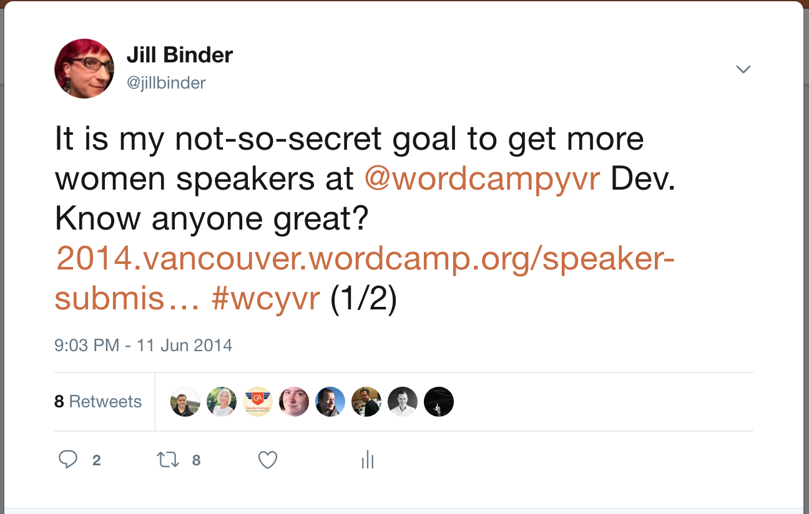
Last Ditch Attempt

Slide 43
Last Ditch Attempt
8 retweets

Slide 44
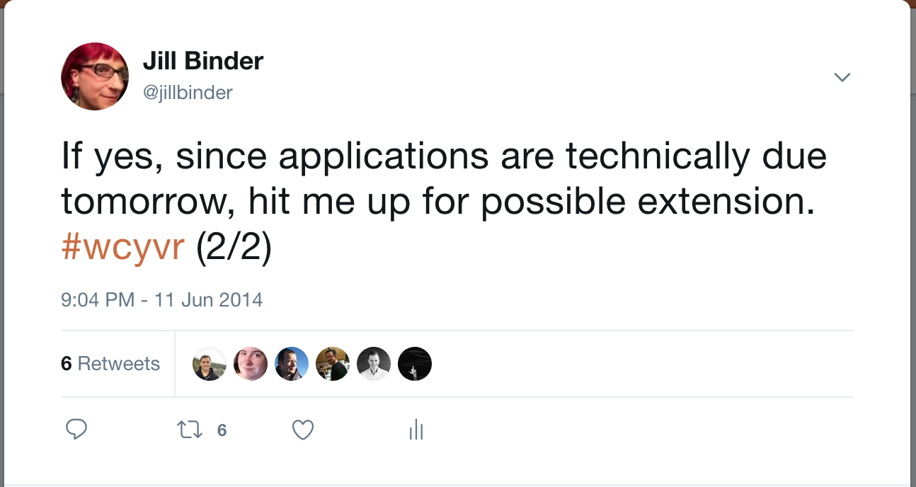
Last Ditch Attempt (Extension)

Slide 45
Other Things We Could Do
Offer childcare
Meetings at different times that work for women with families.
Don’t hold all the events at 9pm at night.

Slide 46
We also…
Not relating to women, but relating to diversity:
Made sure the venue was accessible
Elevator
Single stall washrooms available
Requested no scents

Slide 47
WordCamp Vancouver 2014: Dev Edition
60 applications

Slide 48
WordCamp Vancouver 2014: Dev Edition
18 spots

Slide 49
WordCamp Vancouver 2014: Dev Edition
20 women applied

Slide 50
Three times more women applicants in one year!

Slide 51
Three times more women applicants in one year! (And it was the Dev edition, too)

Slide 52
WordCamp Vancouver 2014: Dev Edition
9 women selected

Slide 53
Chosen speaker selection
9

Slide 54
WordCamp Vancouver 2014: Dev Edition
1 woman and 1 man dropped out last minute
X
X

Slide 55
Final Numbers with Dropouts

Slide 56
We Did This:
4
28
7
17

Slide 57
Community Impact
Diversity in other ways
People of colour
People of different physical abilities
Community leaders

Slide 58
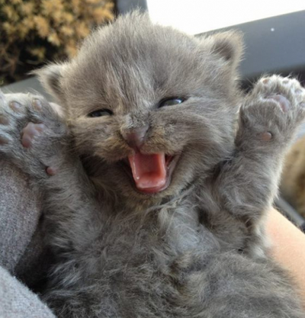

Slide 59
You Can Use It!
https://make.wordpress.org/training/handbook/speaker-training/

Slide 60
Questions / Discussion
Jill Binder
jillbinder.com Twitter: @jillbinder
Notes:
¥ What’s in our workshop
¥ What you can talk about
¥ What to do when ppl who identify as men complain about being left out

