Slide 1
Mobile and Accessibility http://pz.tt/desertmobile

Slide 3
Speech-to-text program
Onscreen magnifier
Keyboard only
Screen reader
Epilepsy / Migraines
Fibromyalgia
Dyslexia
PTSD
Notes:
PWD: 38 million
Physical: 20 million
Cognitive: 14 million
Hearing: 11 million
Vision: 7 million
http://factfinder2.census.gov/faces/tableservices/jsf/pages/productview.xhtml?pid=ACS_12_1YR_S1810&prodType=table

Slide 4
It’s not just about vision impairments
Notes:
PWD: 38 million
Physical: 20 million
Cognitive: 14 million
Hearing: 11 million
Vision: 7 million
http://factfinder2.census.gov/faces/tableservices/jsf/pages/productview.xhtml?pid=ACS_12_1YR_S1810&prodType=table

Slide 5
Our Services
Audits
Mobile testing
Building web sites
CMS testing
Accessible design
Video accessibility
User testing
OS / browser testing
Consultation
Accessible documents

Slide 6
Our Products
OzPlayer
OzART
OzWiki
A11y Voices
More information:
www.accessibilityoz.com

Slide 7
Mobile accessibility features
Native screen readers
TalkBack (Android)
Narrator (Windows)
VoiceOver (iOS)
Text-to-speech / speech recognition
Volume control
Visual, auditory and vibrational notifications
Haptic keyboard
Zoom

Slide 8
Mobile accessibility features
System accessibility settings:
Font size
Touch and hold delay
Screen rotation
High contrast
Assistive touch
Mono audio (left / right balance)

Slide 9
Specific mobile requirements
There is some correlation between mobile site / app issues and the WCAG2 guidelines - however, mobile sites / apps are not specifically covered by WCAG2.
For example, although WCAG2 requires sites /apps to be accessible to the keyboard user it does not specify that it should also be accessible to the mouse or touchscreen user.

Slide 10
Mobile usage

Slide 11
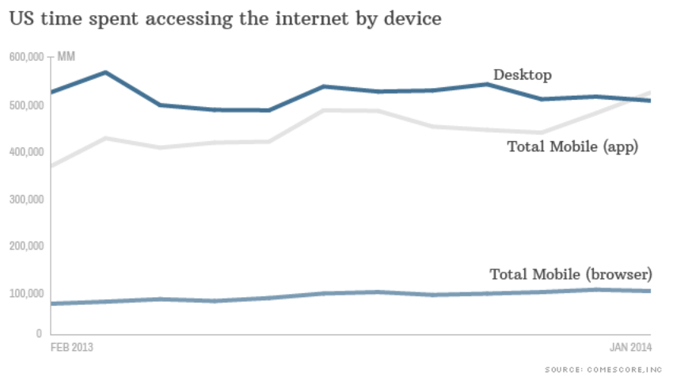
US mobile vs desktop usage
US mobile usage
Notes:
55% of Americans owns smartphones
47% of Americans own tablets
http://money.cnn.com/2014/02/28/technology/mobile/mobile-apps-internet/

Slide 12
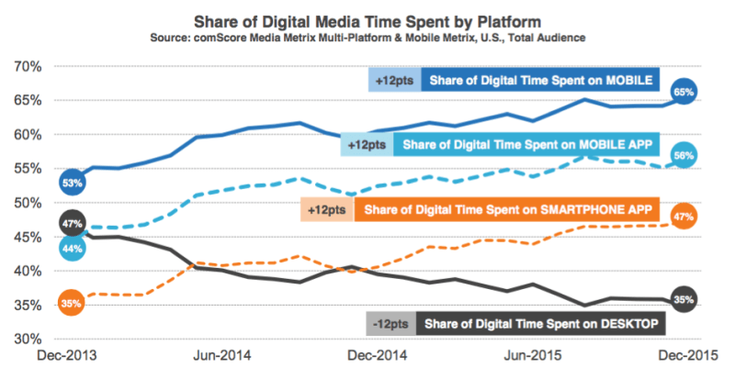
More recent statistics
Notes:
http://marketingland.com/digital-growth-now-coming-mobile-usage-comscore-171505

Slide 13
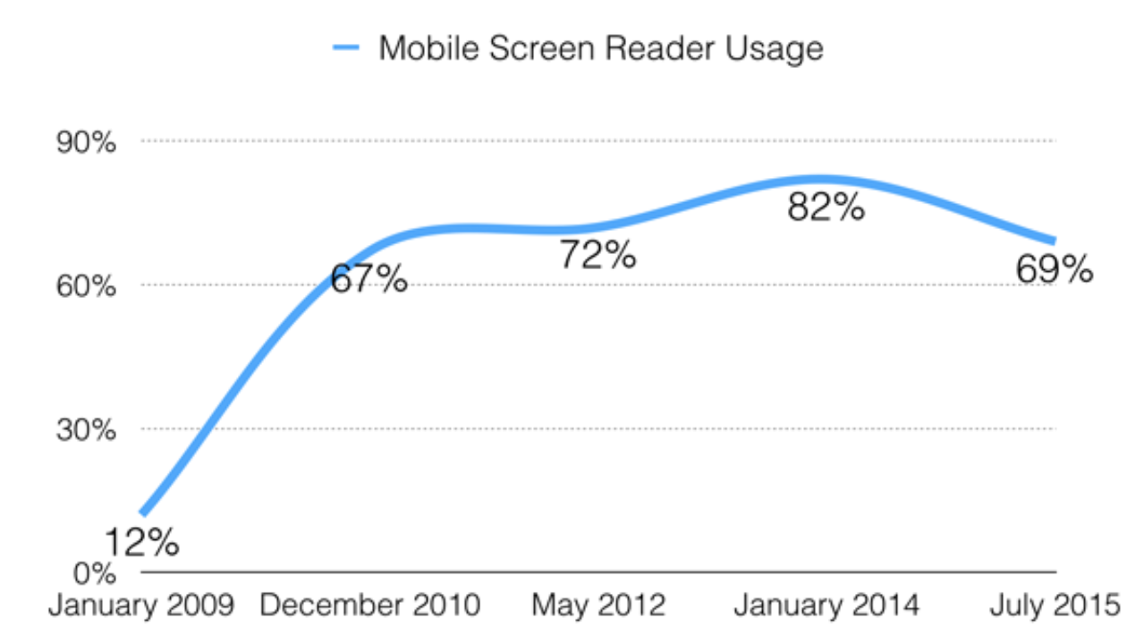
Mobile screen reader use
Percentage of screen reader users that use mobile
Notes:
WebAIM screen reader survey
http://webaim.org/projects/screenreadersurvey5/

Slide 14
Mobile-specific issues
PDFs

Slide 15
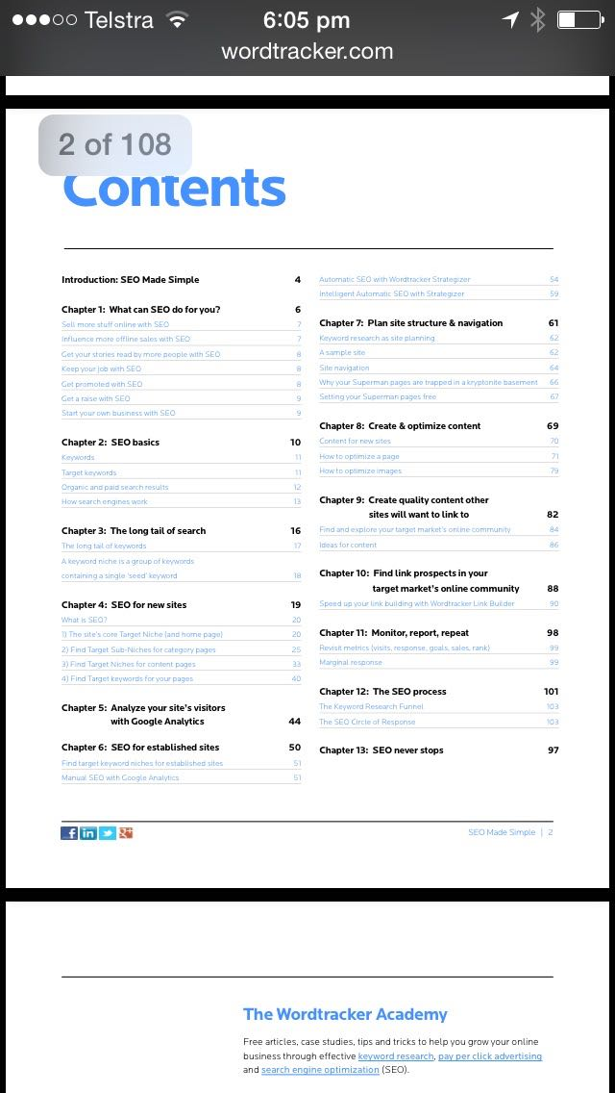
PDFs
Not mobile friendly

Slide 16
PDFs
Which would you prefer?

Slide 17
Larger file sizes + slower connection
equals
longer download + increased data usage

Slide 18
Mobile-specific issues
Friendly to mobile

Slide 19
Mobile sites
Which would you prefer?

Slide 20
Mobile sites
Which would you prefer?

Slide 21
Mobile issues
Autoplay & movement

Slide 22
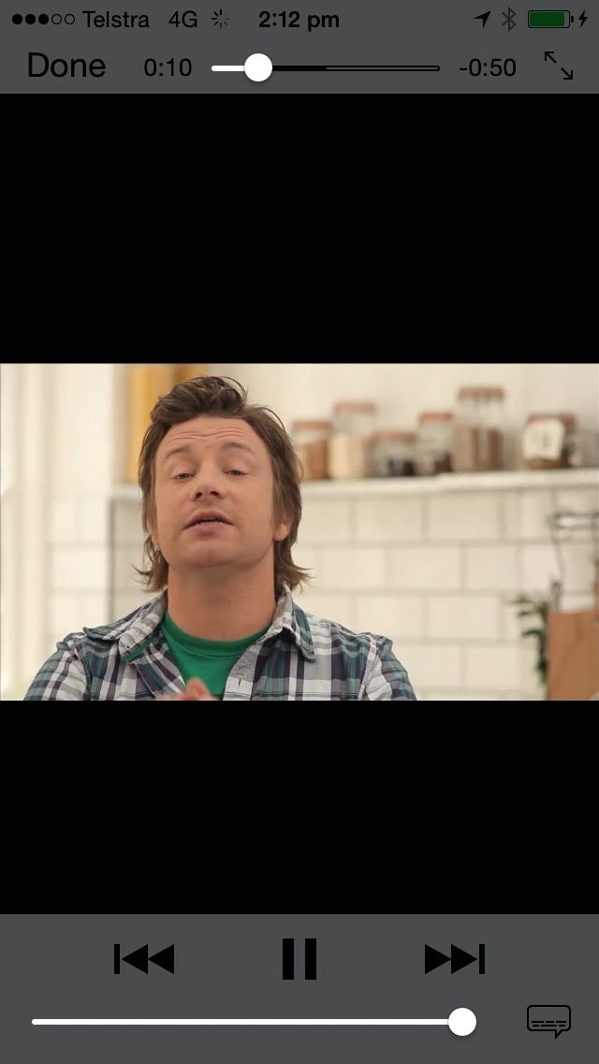
Autoplay
#AccessibilityFail
One of the most serious accessibility failures of all time

Slide 23
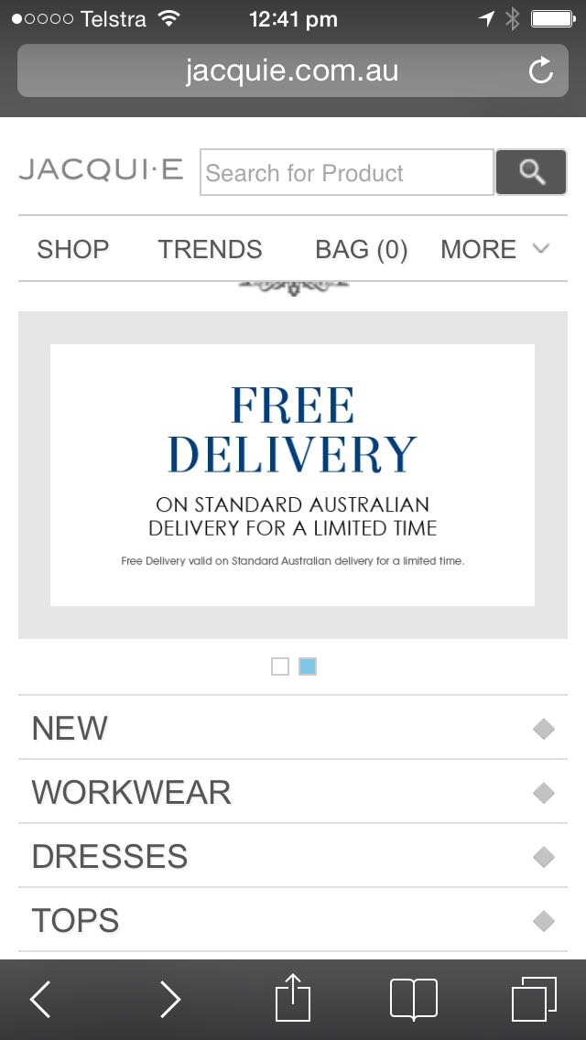
Continuous movement
#Annoying

Slide 24
Mobile issues
Traps

Slide 25
Onscreen keyboard trap
Cannot dismiss keyboard

Slide 26
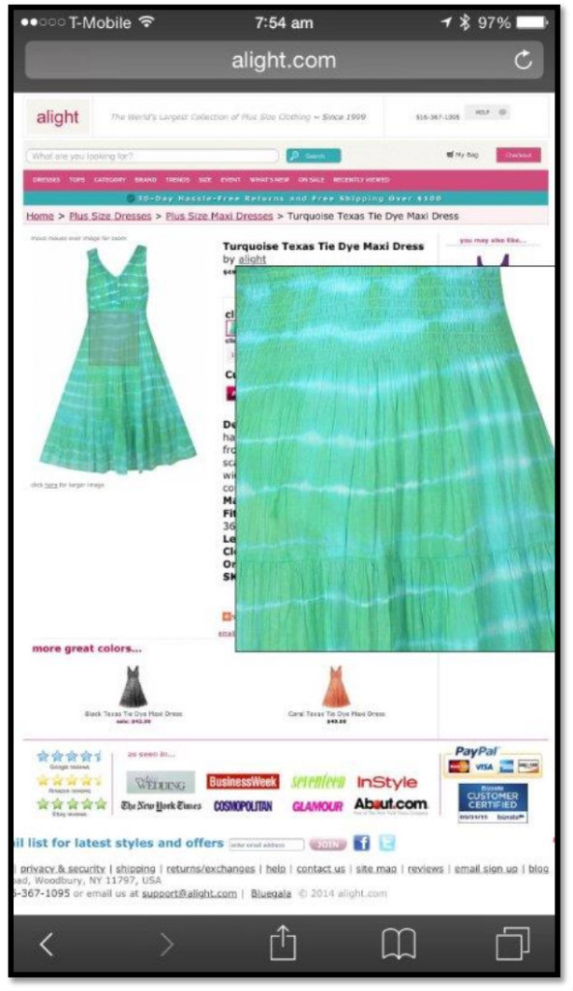
Hover trap
Cannot dismiss zoomed in section

Slide 27
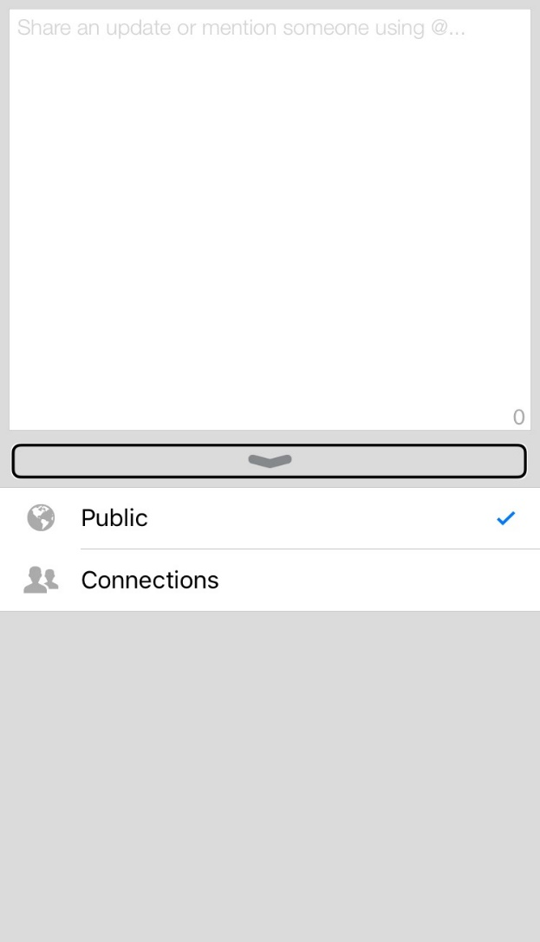
Voiceover swipe trap
LinkedIn – status update
Cannot dismiss page or access keyboard or back buttons

Slide 28
Touch trap
Cannot move the screen unless you activate the up arrow

Slide 29
Mobile issues
Access

Slide 30
Keyboard
Know your inputs

Slide 31
Mobile issues
Text size too small

Slide 32
Text size too small
Too small

Slide 33
Mobile issues
Text size settings not supported

Slide 34
System settings
#TestAllThe Things

Slide 35
System settings
If Apple can’t get it right…

Slide 36
Mobile issues
Large text is not…
large.

Slide 37
In-app settings
Do you call that large text?

Slide 38
In-app settings
Ummm… where is the large text?

Slide 39
Mobile issues
Colour contrast

Slide 40
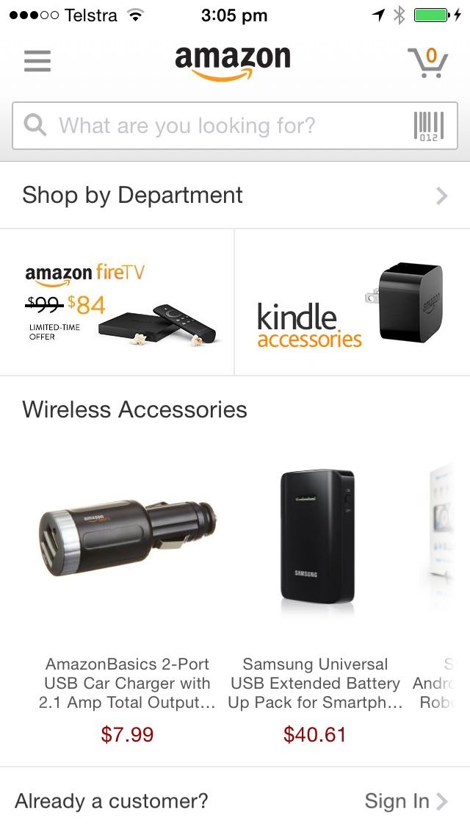
Colour contrast
Grey text on a white background: #JustSayNo

Slide 41
Mobile issues
Broken functionality

Slide 42
Functionality
It’s good if it works…

Slide 43
Functionality
Zooming breaks the site

Slide 44
Fine. I’ll just use the desktop version then…

Slide 45
Desktop / mobile
WTF?!?

Slide 46
Mobile issues
Source order

Slide 47
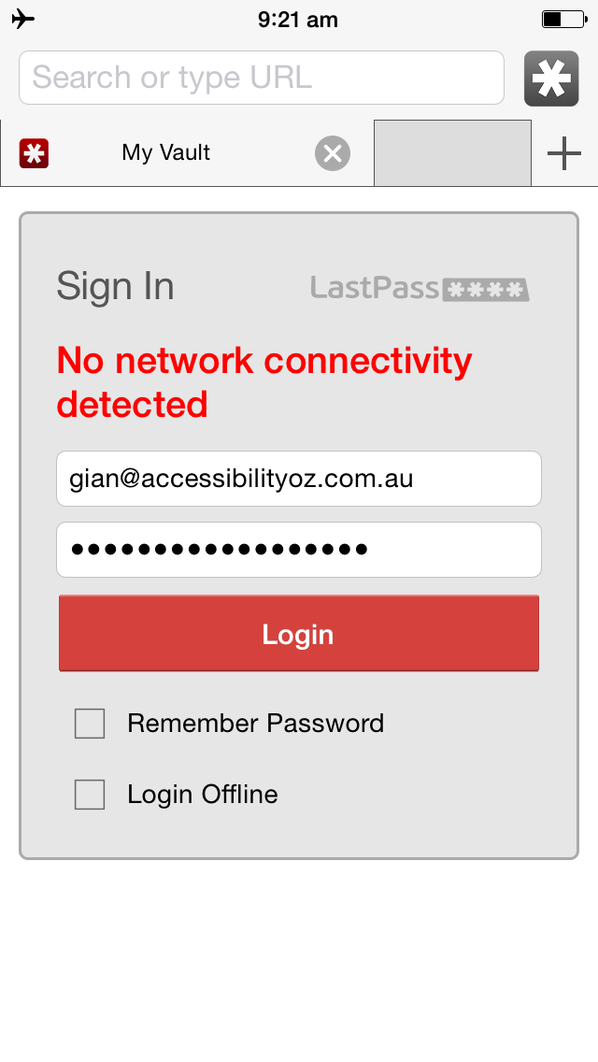
Source order
Important information should never be after a Submit button

Slide 48
Source order
Even Apple can’t get it right…

Slide 49
Mobile issues
Touch targets

Slide 50
Touch targets & maps
Avoid the zoom of doom

Slide 51
Touch targets
Oops!

Slide 52
Mobile issues
Spacing

Slide 53
Spacing
Be careful what you select…

Slide 54
Mobile issues
Lack of testing

Slide 55
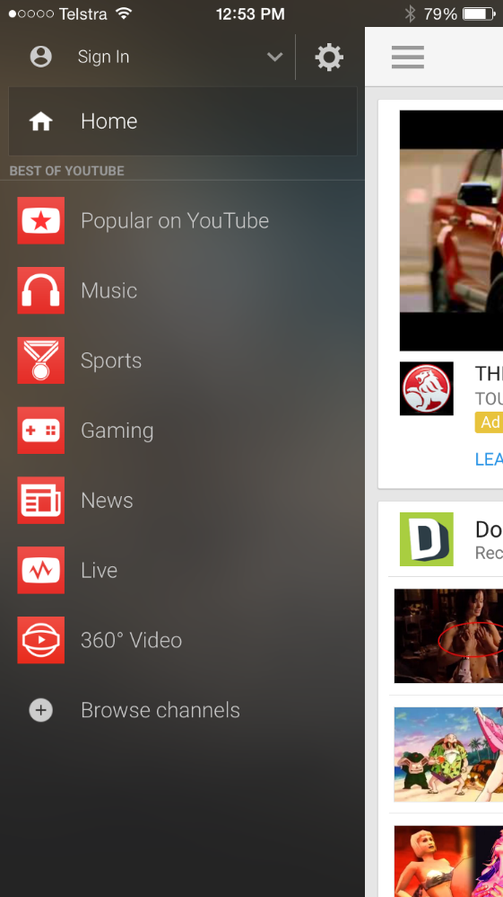
VoiceOver
‘BEST OF YOUTUBE’ read as ‘best of YaToob’
Screenshot of the YouTube mobile app with the menu open. Under the Home link is the text 'Best of YouTube' in all capital letters.
Zoomed in version of the same page.
Screenshot of the YouTube mobile app with the menu open. Under the Home link is the text 'Best of YouTube' in all capital letters.

Slide 56
Search
Ummmm….
No I didn’t

Slide 57
Images
Appropriate sizing

Slide 58
Maps
Where is it exactly?

Slide 59
Scrolling
At least you can scroll…

Slide 60
Testing
#TestAllTheThings

Slide 61
Testing
#TestAllTheThings

Slide 62
Correct implementations

Slide 63
Text size
Size and colour support!

Slide 64
Text size
That’s large text!

Slide 65
Text size
That’s really large text!

Slide 66
Functional zoom
That works!

Slide 67
Indicating functionality
But wait… there’s more!

Slide 68
Indication
But wait… there’s more!

Slide 69
Indication
But wait there’s more!

Slide 70
Indicating functionality

Slide 71
Indicating functionality
And more…

Slide 72
Keyboard
Dismiss and move on!

Slide 73
Keyboard
Correct inputs!

Slide 74
Colour and shape
Know exactly when you have booked

Slide 75
Column width
Width no more than 80 characters…

Slide 76
BBC Mobile accessibility guidelines
a11yoz.com/bbc-mobile

Slide 77
OzWiki: Accessibility Factsheets
https://www.accessibilityoz.com/factsheets/

Slide 78
Questions
http://pz.tt/desertmobile

