Slide 1
8 Ways to Keep Blogging
…Week After Week After Week
Taught by Sharon Ernst

Slide 2
Why Don’t We Blog?
Last on the list
Low priority
Only do it when there’s time
Don’t feel like it
Doesn’t make money (right away)

Slide 3
Why Should We Blog?
Shows expertise
Builds credibility
Helps with SEO…
…and therefore prospects
Gives us content to share

Slide 4
The 8 Ways
Know your goal
Know your audience
Establish your voice
Always have a topic
Use shortcuts
Discover how you like to write
Let go of expectations
Schedule it

Slide 5
Why “Weekly”?
It’s a reasonable goal
It keeps content fresh
It gives you social fodder

Slide 6
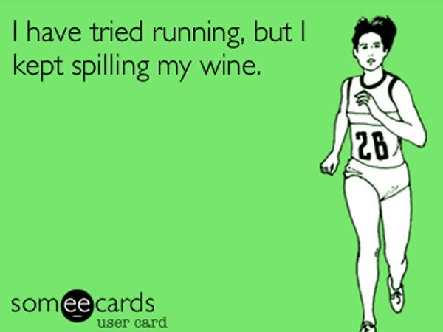
Have a Goal

Slide 7
Step 1: Know Your Goal
No goal = nowhere
Goal can be anything:
Build brand
Establish credibility
SEO
Create newsletter content
Explore ideas
Write a book
Document

Slide 8
Step 2: Know Your Audience
Who are you writing to?
CEOs
Chiropractors
Stay-at-home moms
Why?
What do you want them to get out of it?
What do you want them to do?

Slide 9
Step 3: Establish Your Voice
How do you want to come across?
Funny
Witty
Warm
Authoritative
Confident
Formal
Casual
But always authentic…

Slide 10
Step 4: Always Have a Topic
Keep a running list of ideas
Word doc
Hard copies
Notepad
Phone
Voicemail
Google
Be creative about your topics
What else does your audience care about?

Slide 11
Editorial What??!
Editorial calendars don’t work!
That’s not always what you want to write about
Not timely
Not flexible

Slide 12
Step 5: Use Shortcuts
Create a blog post even when you don’t have time
Shortcuts can be:
Funny stuff you find
Photographs
Links to websites, articles or blog posts
Videos
Repurposed content
A list of your blog posts
Checklists

Slide 13
Shortcuts…

Slide 14
Shortcuts…
Relevant memes, cartoons
Photos of finished projects
Photos of happy customers
Links to websites, articles
Links to videos, classes
Content you’ve created like ebooks

Slide 15
Step 6: Discover How You Like to Write
Discover how you like to write = you will write
On paper, in Word or in Wordpress
At your desk or the coffeeshop
In the morning or the evening
When it’s quiet or with music
With wine or with coffee
Plus you’re training your brain…

Slide 16
Recap so far…
Be clear on your goal
And your audience
And your voice
Have a running list of ideas
Have a stash of shortcuts
How do you like to write?

Slide 17
Step 7: Let Go of Expectations
Not every post = perfect
You’ll have good days and bad ones
Key is to keep going!

Slide 18
Step 8: Schedule Time!
Commit to a time
Make it weekly
Write it in pen
Say you’re busy…because you are!
Reward yourself
Be held accountable
(Try to factor in time for proofreading!)

Slide 19
Bonus Tip: Just Keep Blogging
The more you blog, the easier it is to stick with it.

Slide 20
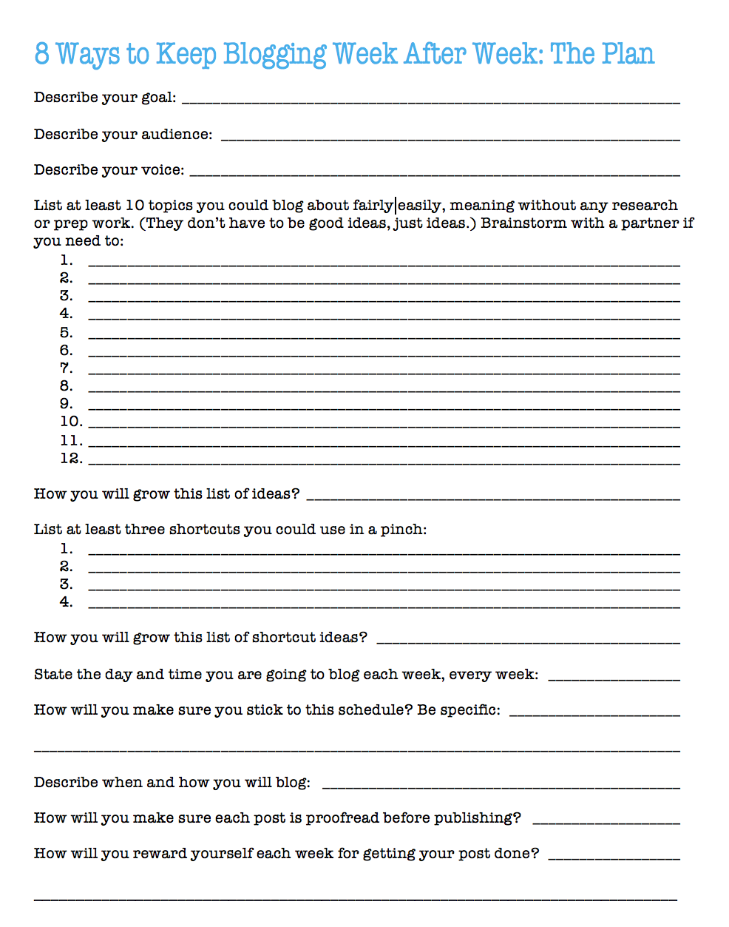
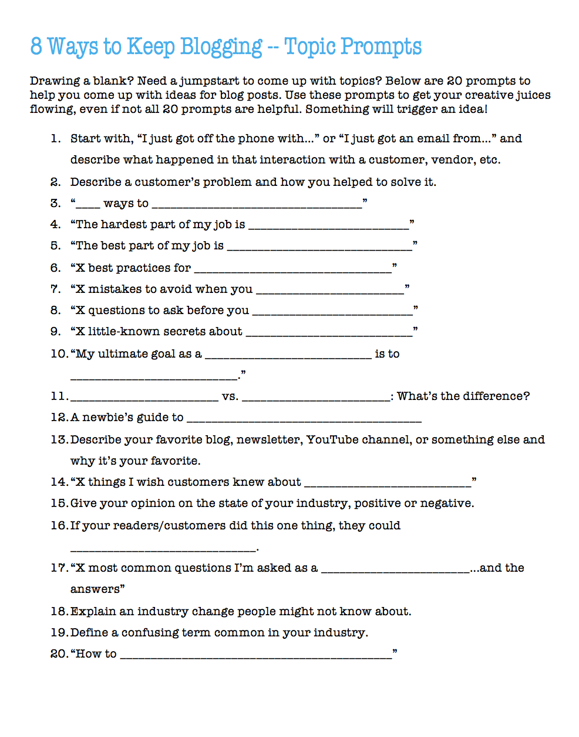
Printouts

Slide 21
Time for the Plan!
Describe your goal.
Describe your audience.
Describe your voice.
List at least 10 topics. (10 minutes)
How you will grow this list?
List at least three shortcuts.
How you will grow this list?
State the day and time you are going to blog.
How will you make sure you stick to this schedule?
Describe when and how you will blog.
How will you make sure each post is proofread before publishing?
How will you reward yourself each week for getting your post done?

Slide 22
Thank You! Now Go Blog…
This topic as an online class:
http://skl.sh/2xRboIv
Contact:
sharon@betterfasterwriter.com
Get weekly tips for writing better, faster:
www.betterfasterwriter.com

